Slide 1

Online Book Store (MERN Stack)
NAME : AMARAGONDA ADHITHYA
REG NO : 12212304
EMAIL : adhithyaamaragonda@gmail.com
GitHub: github.com/ADHITHYAAMARAGONDA/BOOK-STORE
SUPERVISED BY : VENKATESH
DEPARTMENT OF COMPUTER SCIENCE AND ENGINEERING,
LPU, Phagwara

Slide 2

Introduction
Online Book Store Project
The Online Book Store is a full-stack web application developed using the MERN stack (MongoDB, Express.js, React.js, and Node.js). This project provides a digital platform for users to browse, search, and manage books, simulating a real-world e-commerce experience. It includes user authentication, CRUD operations for books, and a responsive interface. The application demonstrates modern web development practices, making it a practical solution for managing online book sales.

Slide 3
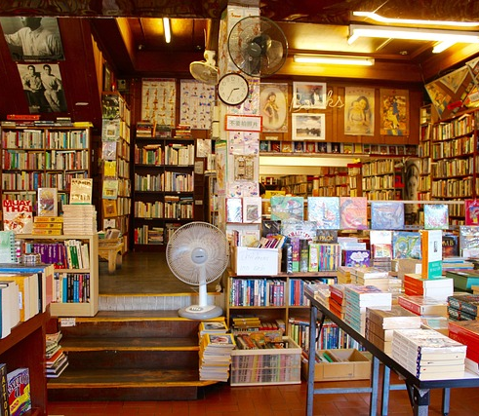
PROJECT DETAILING
Project Detailing – Online Book Store
🔹 Project Title:
Online Book Store (MERN Stack Based Web Application)
🔹 Description:
A web-based platform where users can register, log in, and explore a wide collection of books. Admin users can add, edit, or delete books from the store. This project provides a real-time experience of a working e-commerce application.
🔹 Frontend:
Built using React.js
React Hooks and functional components
API Integration using Axios
Routing handled using React Router
Styled with CSS

Slide 4
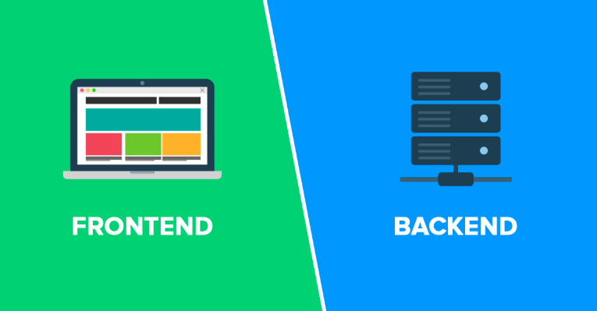
🔹 Backend:
Node.js with Express.js as framework
RESTful APIs to handle frontend requests
MongoDB used for storing user and book data
JWT-based authentication and authorization
🔹 Key Modules:
User Module: Registration, Login, Book Browsing
Authentication: Secure login system using JWT tokens
Book CRUD: Fully functional book create, read, update, delete features
Cart System: Add or remove books for checkout simulation
🔹 Repository:
GitHub - https://github.com/ADHITHYAAMARAGONDA/BOOK-STORE

Slide 5
References
MERN Stack Tutorials on Youtube from CodeCamp.

Slide 6

Database Management
MongoDB serves as the database management solution, storing both user and book data securely. Its flexible schema design allows for easy manipulation and retrieval of information, accommodating the CRUD operations essential for this e-commerce platform. Proper indexing and data modeling strategies ensure optimal performance and quick access to data.

Slide 7
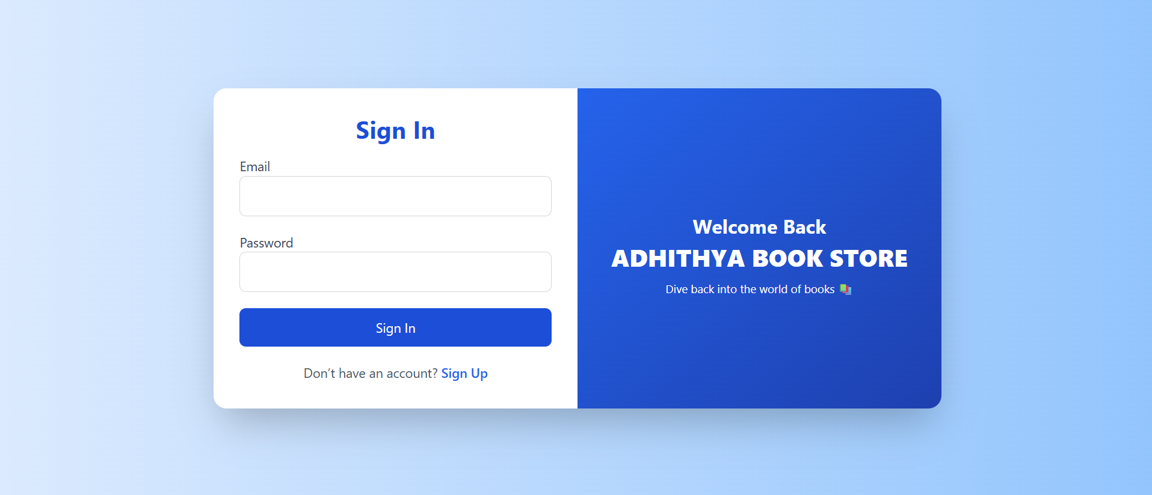
Register / Login

Slide 8
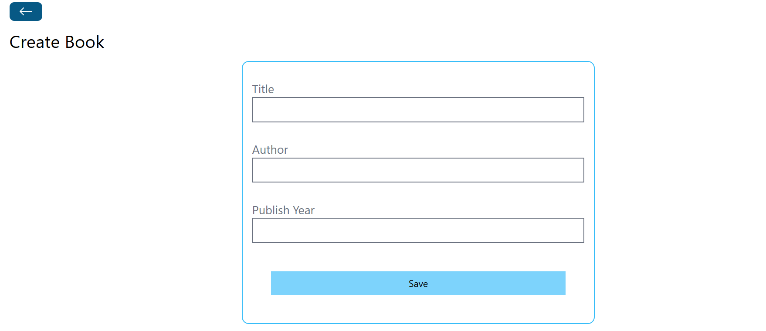
CREATE BOOK :

Slide 9
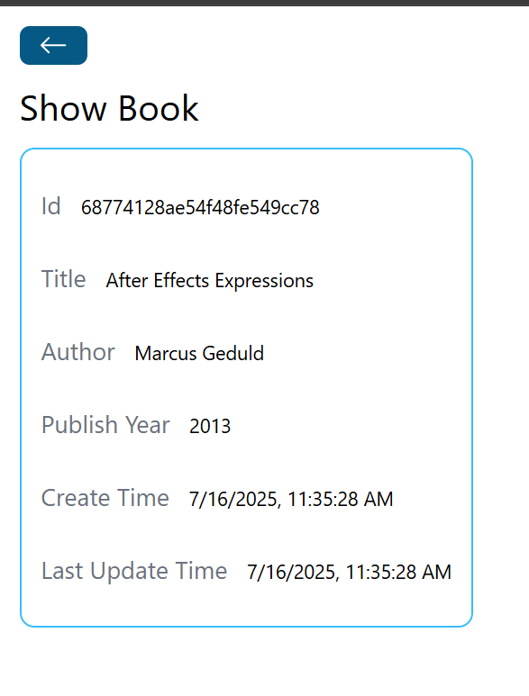
SHOW A BOOK :

Slide 10
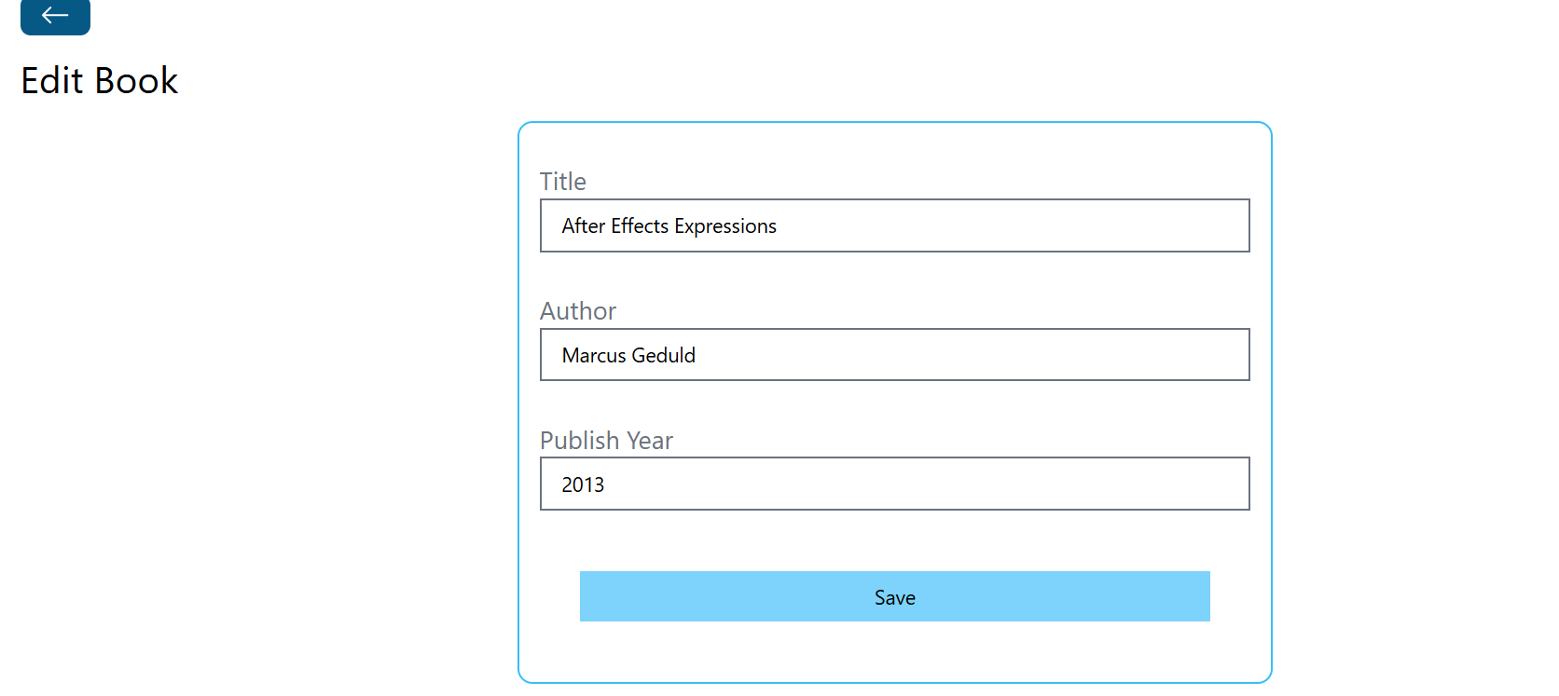
EDIT BOOK :

Slide 11
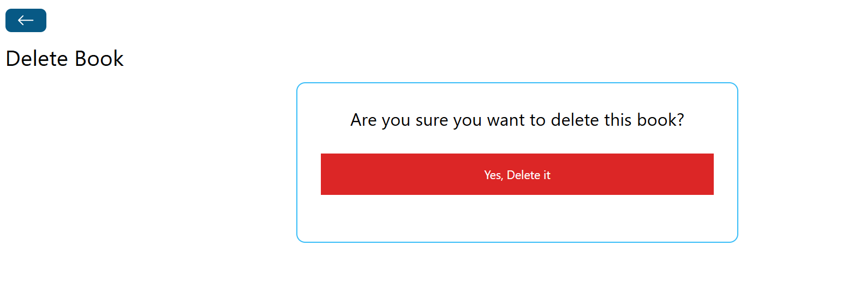
DELETE A BOOK :

Slide 12
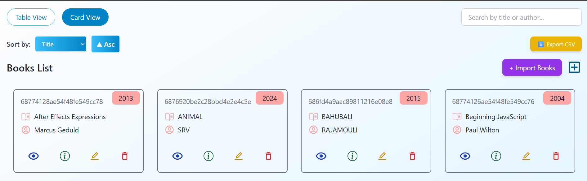
CARD VIEW :

Slide 13
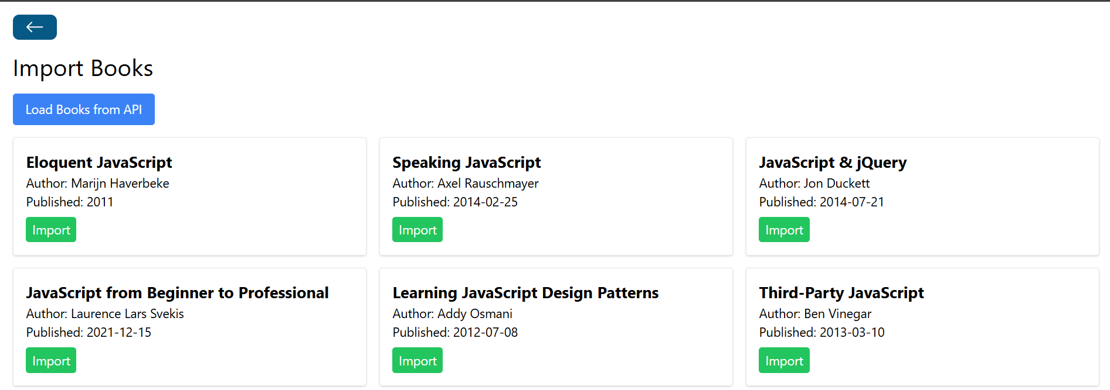
IMPORT BOOKS :

Slide 14

Future Scope
Integrate Payment Gateway: Add secure payment options like Stripe or Razorpay for real transactions.
User Reviews & Ratings: Allow users to rate and review books to enhance engagement.
Order History & Tracking: Enable users to view their past orders and track shipments.
Wishlist & Recommendations: Personalized book suggestions and wishlist management.

Slide 15

Admin Analytics Dashboard: Insights on sales, popular books, and user activity.
Mobile App Development: Build a mobile-friendly app version for better accessibility.
Real-time Notifications: Alerts for offers, new arrivals, and order status updates.

Slide 16

Conclusions
The Online Book Store project has successfully merged advanced technologies to create a full-stack e-commerce application. It demonstrates efficient practices in development, robust tech stack utilization, and a user-centric design approach. This project not only enhances technical skills but also prepares for real-world application deployment and management.

Slide 17
Thank You !
Github : https://github.com/ADHITHYAAMARAGONDA

